Slide 1
Random Variables
&
Expected Value

Slide 2
Topics
Discrete random variables
Expected frequency
Expected value

Slide 3
Topics
Discrete random variables
Expected frequency
Expected value

Slide 4
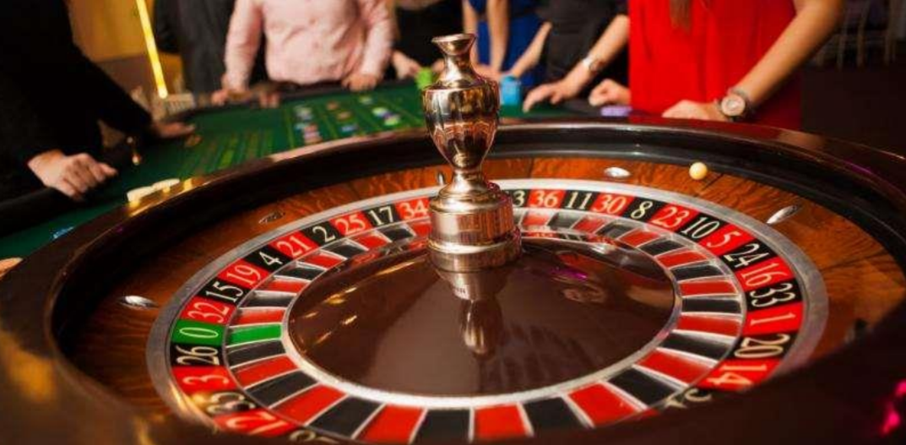
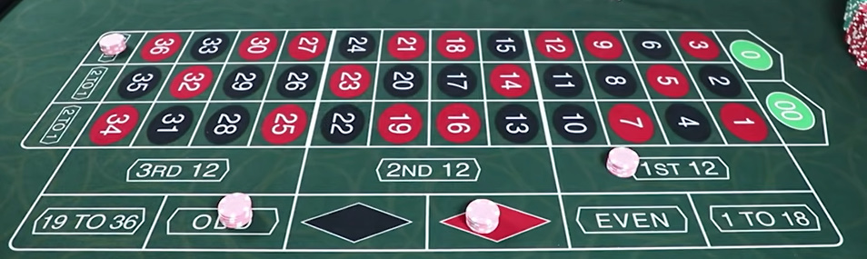

Slide 5
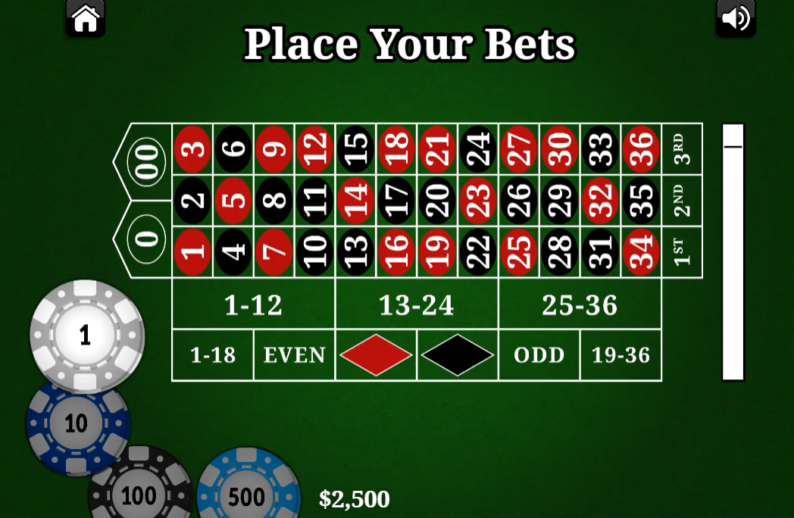
Notes:
Roulette 轮盘赌

Slide 6
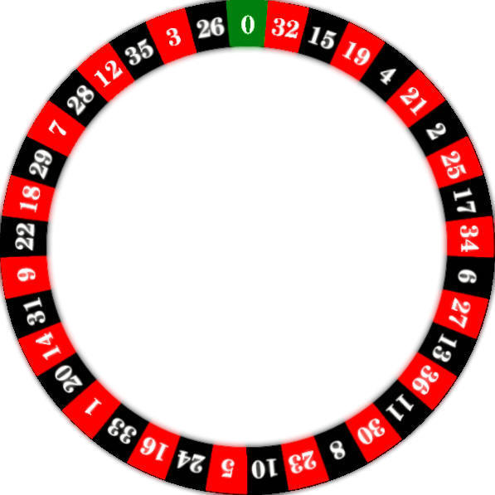
Random Experiments
We know the probability of every possible outcome.
P(black)=18/37
P(red)=18/37
P(green)=1/37
But we do not know what would be the next outcome!!!
{black} or {red} or {green}
18 Black Spaces
18 Red Spaces
1 Green Space

Slide 7
Random Events
Three random events:
A = {black}
B = {red}
C = {green}
18 Black Spaces
18 Red Spaces
1 Green Space

Slide 8

Random Events
Let’s bet on black for $100
Random event: A = {black}
18 Black Spaces
18 Red Spaces
1 Green Space
Quantify random events
X = $\left\{\begin{aligned}\text{\$100}\text{, }if A occurs \\ −\text{\$100}\text{, }\text{if} \text{A} does not occur\end{aligned}\right.$

Slide 9
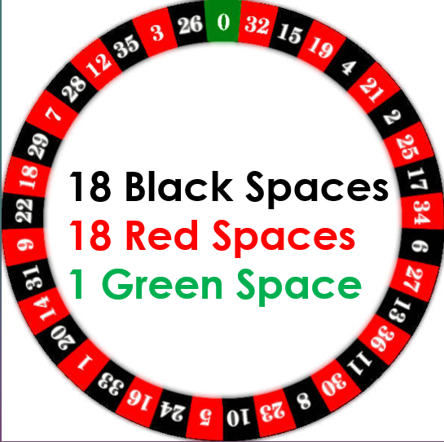
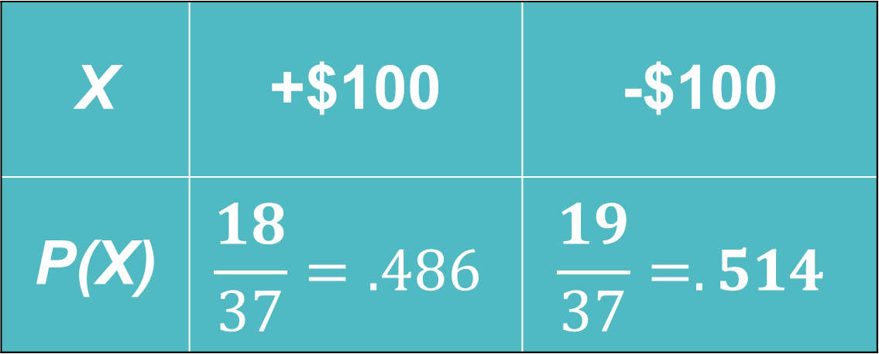
Random Variables
Def: A random variable takes numerical values that describe the outcomes of a chance process.
X | +$100 | -$100
P(X) | $$\frac{18}{37}=.486$$ | $$\frac{19}{37}=.514$$

Slide 10

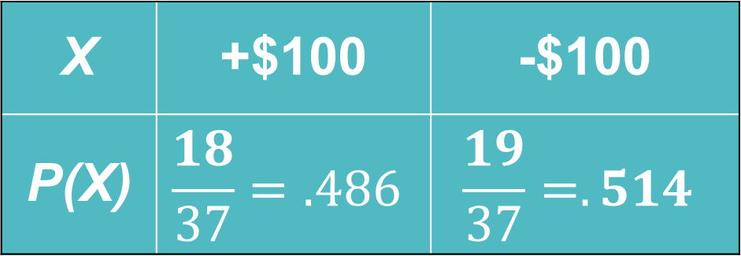


Regular Variable Random Variable
$$(x)$$
$$(X)$$
$$x+2=5$$
$x=3$
X = amount of winnings
X | +$100 | -$100
P(X) | $$\frac{18}{37}=.486$$ | $$\frac{19}{37}=.514$$
It already exists and we solve for it.
Represents an outcome that hasn’t occurred yet.

Slide 11
Topics
Discrete random variables
Expected frequency
Expected value

Slide 12
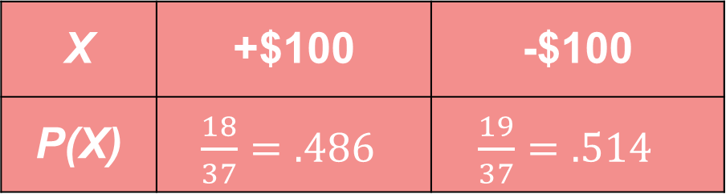
Expected Frequency
1. If I were to play 1000 times, how many times would expect black to win?
We’d expect to get black 486 times of the 1000 times we played.
X | +$100 | -$100
P(X) | $\frac{18}{37}=.486$ | $\frac{19}{37}=.514$

Slide 13
Topics
Discrete random variables
Expected frequency
Expected value

Slide 14
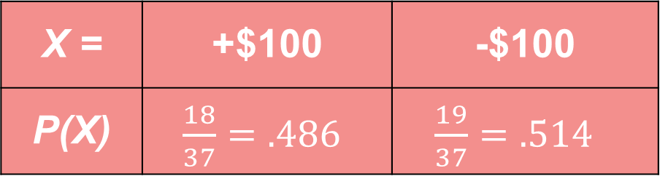

Expected Value
If I were to play 1000 times, what would my average winnings be per play?
Expect to win: $0.486∗1000=486$ times
Expect to lose: $0.514∗1000=514$ times
X = | +$100 | -$100
P(X) | $\frac{18}{37}=.486$ | $\frac{19}{37}=.514$

Slide 15

Expected Value
If I were to play 1000 times, what would my average winnings be per play?
Expected winnings: $486$ * $100 = $48,600
Expected loss: $514$ * -$100 = -$51,400
+
= -$2,800
Expected “winnings” after 1,000 plays
X = | +$100 | -$100
P(X) | $\frac{18}{37}=.486$ | $\frac{19}{37}=.514$

Slide 16
Expected Value
If I were to play 1000 times, what would my average winnings be per play?
Expected winnings: $486$ * $100 = $48,600
Expected loss: $514$ * -$100 = -$51,400
+
= -$2,800
Expected “winnings” after 1,000 plays
Average “winnings” per play:
-$2,800/1000 = -$2.80

Slide 17
Expected Value
Expected Value: the average value of a chance process, after repeating many trials.
Note: Losing $2.80 is not a possible outcome for one spin (+/- $100 are the only outcomes).
The expected values tells you the average over many trials, not the result of a single trial.
Expected Value of Roulette = -$2.80
Interpretation: after many trials, the average winnings for roulette is actually a loss of $2.80 per play.

Slide 18
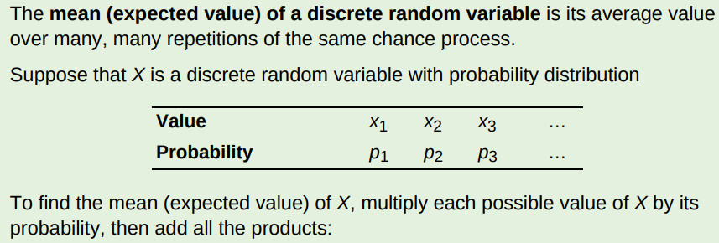
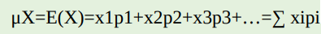

Slide 19

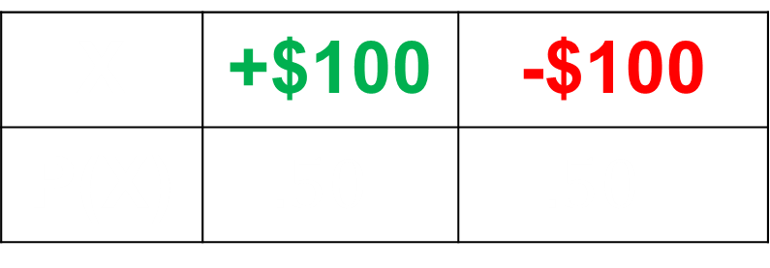
Calculating Expected Value
Example 1: You play a coin toss game. Heads means you get $100, tails means you lose $100. Find the expected value.
Let X = winnings from game
X | +$100 | -$100
P(X) | $.50$ | $.50$
$$E\left(X\right)=0.50∗100−0.50∗100$$
$=\$0$

Slide 20
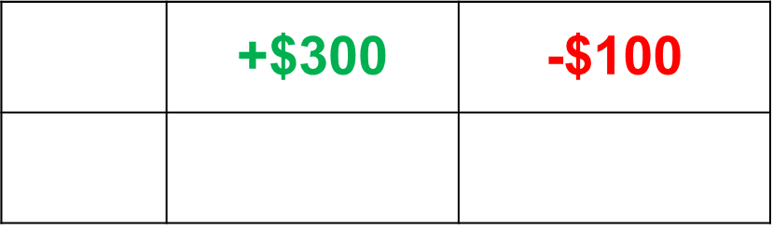
Calculating Expected Value
Example 2: You play a coin toss game. Heads means you get $300, tails means you lose $100. Find the expected value.
X | +$300 | -$100
P(X) | $.50$ | $.50$
$$E\left(X\right)=0.50∗300−0.50∗100=\$100$$

Slide 21
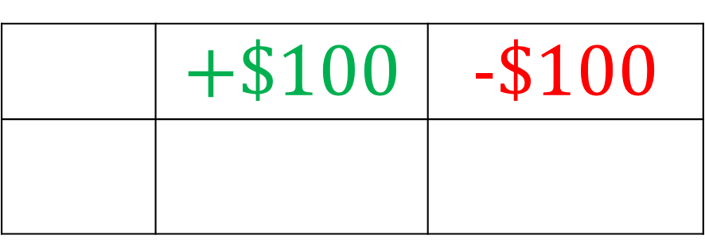
Example 3: You play a coin toss game. The coin is weighted so that there is a 75% chance of tails. Heads means you get $100, tails means you lose $100. Find the expected value.
$$E\left(X\right)=0.25∗100−0.75∗100=−\$50$$
X = | +$100 | -$100
P(X) | $.25$ | $.75$

Slide 22

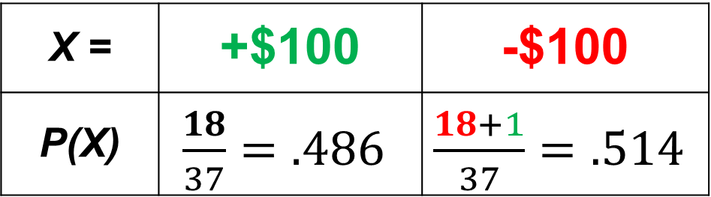
Expected Value – Roulette
X = amount of winnings
E(X)=?
18 Black Spaces
18 Red Spaces
1 Green Space
X = | +$100 | -$100
P(X) | $\frac{18}{37}=.486$ | $\frac{18+1}{37}=.514$
Betting on black:
$$0.486∗100 + 0.514∗\left(−100\right)=−\$2.80$$

Slide 23

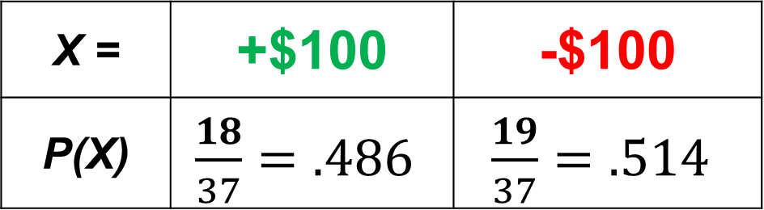
Expected Value – Roulette
Individuals don’t have many trials, but casinos do. They profit through long run expected values.
X = | +$100 | -$100
P(X) | $\frac{18}{37}=.486$ | $\frac{19}{37}=.514$
Expected loss for 1,000 plays:
$$−2.80∗1000=−\$2,800$$
Expected casino profit for 1,000 plays:
$$+2.80∗1000=+\$2,800$$
18 Black Spaces
18 Red Spaces
1 Green Space

Slide 24
A “Good Game”
Imagine the casinos didn’t take AP Stats. They come up with this game for high-rollers:
You roll a 6-sided dice. If you roll 5-6, you get $1,000,000.
If you roll 1-4, you have to pay $300,000.
Discussion Question: If you could play this game only once, would you play? Why or why not? Mention the expected value in your answer.
X = | +$1,000,000 | -$300,000
P(X)

Slide 25
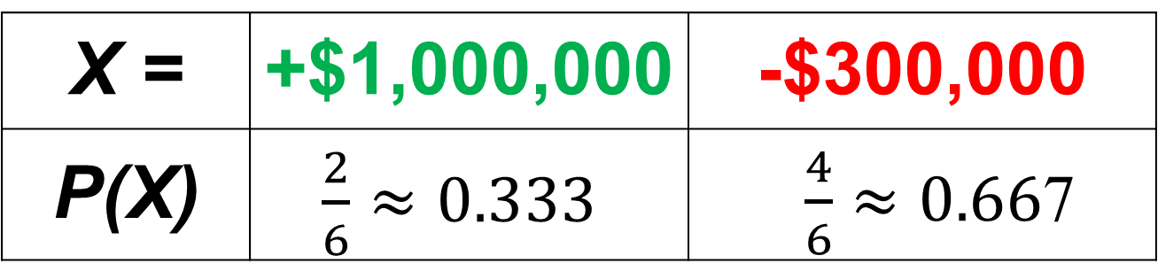
A “Good Game”
Even though the expected value is positive, you have a great chance of losing A LOT of money. A gain of $1mil is extremely nice, but a loss of $300k can be devastating. This game has high variability, which makes it unplayable for most people.
Discussion Question: If you could play this game only once, would you play? Why or why not?
$0.333∗\$1,000,000+0.667∗\left(−\$300,000\right)≈$ $132,900
(+333,000) +
(-200,100) ≈ +132,900
X = | +$1,000,000 | -$300,000
P(X) | $\frac{2}{6}≈0.333$ | $\frac{4}{6}≈0.66$7

